Slide 1
HemTools design
Yichao Li

Slide 2
Features
Integration of multiple, different types of tools
Pure python
Pure R with python wrapper
Pure Bash with python wrapper
OS-dependent job submission
User-oriented design

Slide 3
Common types (ways of integration)
1. from job script pipeline
E.g. capture.lsf
Develop has to write a python wrapper with args parser
Assume that .lsf file has handled all input and output files well

Slide 4
Most easy one
HemTools standalone
Well polished python script
Just copy to bin
Run directly from terminal
Each script may have redundant functions, e.g., send email.
But each of them is independent, they are executable in any dir.
HemTools api --list
Show all available executables

Slide 5
HemTools code structure
Bin
- all exec
no hard-coded data allowed, they should be specified in hemtools.config
Each file here is directly execuable, each one should have a short summary
Each file is also an API, in future, new functions can be added without touching other files
Share
- misc files, structure design by develop, not enforced
E.g., template files
config
Hemtools.config
Data.config
Specify data path
E.g., human genome index
Utils
Python functions
Test
Test datasets and one-liner testing script

Slide 6
Check input
Input file existence
Input file format

Slide 7
Check job status
If run OK
Should show in the returned email

Slide 8
Publication, general usage
NGS pipeline is not enough for publication
Have you filled any gaps?
Do you have any unique features?
Curated blood lineage dataset
For research in this field to do enrichment analysis
https://github.com/nf-core/
Pipeliner: A Nextflow-based framework for the definition of sequencing data processing pipelines
Etc
Not really significant
A generic pipeline is not good, all pipeline should be optimized to your OS! IBM Spectrum LSF
Here we provide a pipeline that is based on pure python, we also provide details about how to optimize this pipeline (mainly parallelism) to your system.

Slide 9
A good pipeline depends on
Easy of use
No installation needed
Less parameters or parameters have been optimized by developers
Parallelism
Visually-appealing output
In summary
Leave all the work to developers
Less troublesome to users

Slide 10
Job type
Interactive
Array job

Slide 11
Job dependency
Job specification file
Job_name
--------------
commands

Slide 12
Method to add API (simple)
Just copy the finished .py to bin folder
Docstring will be parsed by HemTools

Slide 13
Method to develop API (TODO)
Every API has
Argparse
Email system
optional
Output organization system
Logging system
Config system

Slide 14
Method to develop API (cont.) DONE
Example 1
Circos Manhanttan plot
This is a simple script
Run interactively
This kind of script just need to copy to the bin dir

Slide 15
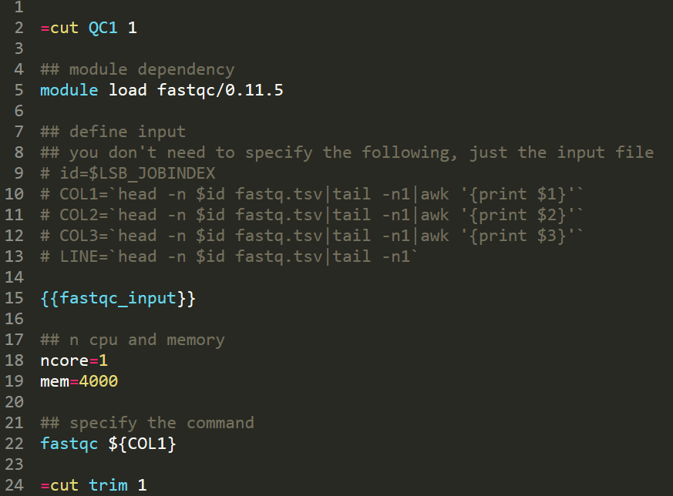
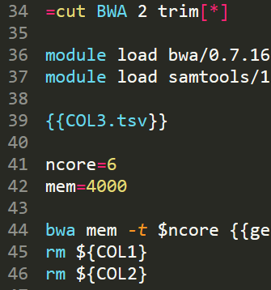

Method to develop API (cont.)
Example 2
ATAC-seq
This is a complex script with LSF job script
A cut label

Slide 16
Method to develop API (cont.)
Example 3
CaptureC (no dependency job mode)
I have a workable lsf script, how do I integrated into HemTools?
1. put your lsf file into share/lsf/
2. write a python script, import utils, let it help your to make input files, put the python script in bin/

Slide 17
Method to develop API (cont.)
Example 6
CaptureC (with dependency job mode, use =cut label)
I have a workable lsf script, how do I integrated into HemTools?
Assume input and output is specificed using ${COL3}
Some program has internal naming, which you can’t control
In such cases, you should add a renaming command in your lsf script
1. put your lsf file into share/lsf/
2. write a python script, import utils, let it help your to make input files, put the python script in bin/
There are two types of dependency, one is order dep [*], the other one is just ended all. Please use
=cut 2 # for ended all
=cut 2 [*] # for order dep

Slide 18
Method to develop API (cont.) not recommanded
Example 4
CaptureC
I have a workable lsf script, I don’t want to write a python script, how do I integrated into HemTools?
1. put your lsf file into share/lsf/
2. since you don’t want to write a script, you have to manually provide the input list, then I have a python script that
Parse your lsf, using `=cut` for job-splitting parallelization
Run_lsf your_lsf

Slide 19
Method to develop API (cont.) not recommanded
Example 3
CaptureC (no dependency job mode)
I have a workable lsf script, how do I integrated into HemTools?
1. put your lsf file into share/lsf/
2.

Slide 20
Pipeline charts

Slide 21
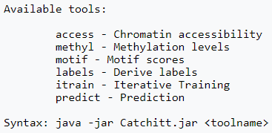
ATAC.list
motif.list
TFBS prediction pipeline
access
motif
Featurization
Feature Matrix
itrain
TF Peaks
labels
ML model
predict
Predicted TFBSs

